Slide 1
Introduction to Social Research

Slide 2
Purpose of Research?
The basic purpose of Research is to produce
Knowledge and
understanding

Slide 5
What is Social Research?
Research is a scientific and systematic search for information
P.V. Young: social research is a systematic method of discovering new facts or verifying the old facts, their sequences, inter-relationship, casual explanations and the natural laws which govern them
(Quantitative Perspective)

Slide 6
Qualitative perspective:
‘‘The systematic collection, organization, and interpretation of textual material derived from talk or conversation. It is used in the exploration of meanings of social phenomena as experienced by individuals themselves, in their natural context’’
(Malterud, 2001, p. 483).

Slide 7
Objectives of research
The purpose of research is:
To discover answers to questions through the application of scientific procedures.
To gain familiarity with a phenomenon or to achieve new insights into it (studies with this object in view are termed as exploratory or formulate research studies)
To portray accurately the characteristics of a particular individual, situation or a group (studies with this object in view are known as descriptive research studies)
To determine the frequency with which something occurs or with which it is associated with something else (studies with this object in view are known as diagnostic research studies)
To test a hypothesis of a causal relationship between variables (such studies are known as hypothesis-testing research studies)

Slide 8
Types of Research
Two types of Research :
Qualitative
2. Quantitative

Slide 9
Qualitative Vs. Quantitative
Qualitative
An inquiry which seeks to understand social phenomena through the exploration and interpretation of the meanings people attach to, and make sense of, their experiences of the social world “
Associated with the:
Interpretive paradigm
Key principle:
Subjectivity/interpretation
Theory developed:
during and/or after the study (theory generation)
Process: Inductive

Slide 10
Quantitative
An inquiry based on testing a theory composed of variables, measured with numbers and analysed with statistical procedures, in order to determine whether the predictive generalisations of the theory hold true
Associated with:
Post/positivist paradigm
Key principle:
Objectivity
Theory Production:
before the study (theory verification) (Hypotho-deductive)
Process: Deductive

Slide 11
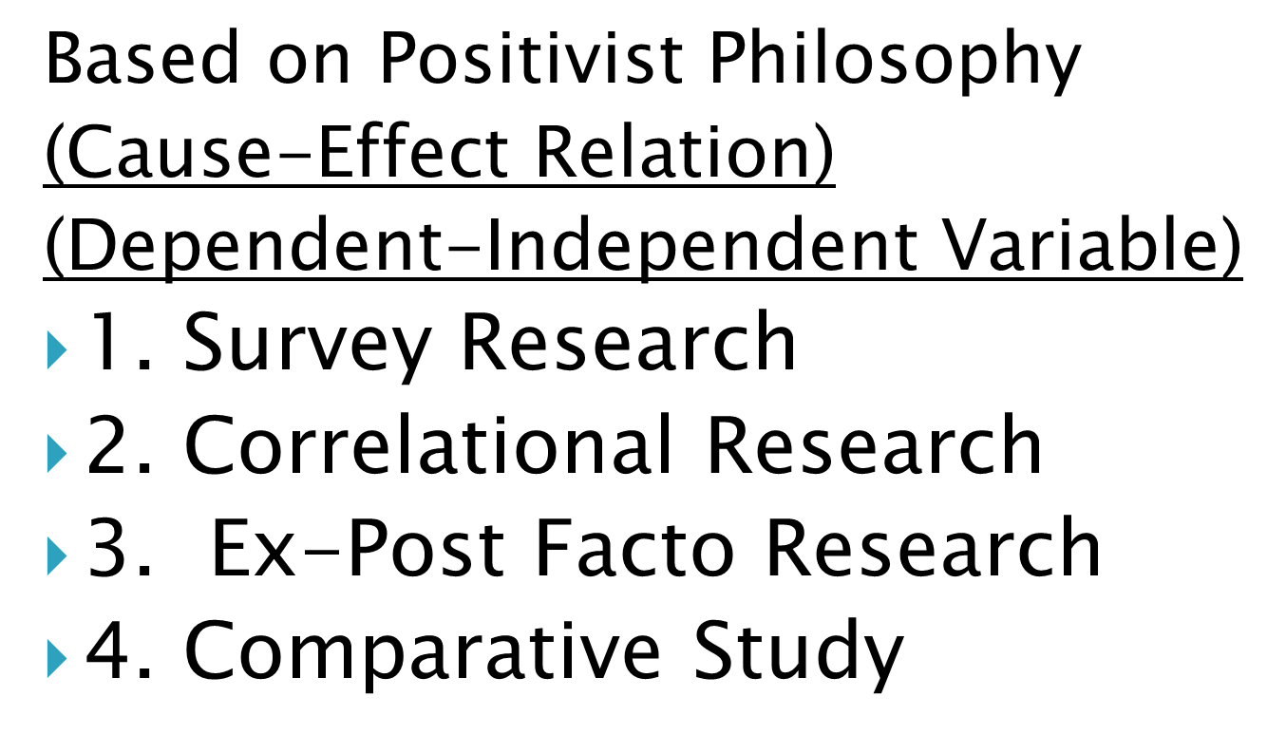
Techniques of Qualitative
Based on the Interpretivists Philosophy of Symbolic Interactionism
1. Ethnographic Research
2. Grounded Research
3. Phenomenological Research

Slide 12
Ethnographic research
is a qualitative method here researchers observe and/or interact with a study's participants in their real-life environment.
Ethnography was popularized by anthropology, but is used across a wide range of social sciences.

Slide 13
Grounded Research
Grounded Theory is an inductive methodology.
It is the systematic generation of theory from systematic research.
It is a set of rigorous research procedures leading to the emergence of conceptual categories.

Slide 14
Phenomenology
is a qualitative research method that is used to describe how human beings experience a certain phenomenon.
A phenomenological study attempts to set aside biases and preconceived assumptions about human experiences, feelings, and responses to a particular situation.

Slide 15
Techniques of Quantitative
Based on Positivist Philosophy
(Cause-Effect Relation)
(Dependent-Independent Variable)
1. Survey Research
2. Correlational Research
3. Ex-Post Facto Research
4. Comparative Study

Slide 16
5. Cross Sectional study
6. longitudinal study

Slide 17
In survey research, the researcher selects a sample of respondents from a population and administers a standardized questionnaire to them.
The questionnaire, or survey, can be a written document that is completed by the person being surveyed, an online questionnaire, a face-to-face interview, or a telephone interview.
Correlational research Correlational research is a type of non-experimental research method, in which a researcher measures two variables, understands and assess the statistical relationship between them with no influence from any extraneous variable.

Slide 18
Ex-post-facto research examine how an independent variable, present prior to the study in the participants, affects a dependent variable.
When translated literally, ex post facto means ‘from what is done afterwards’.
In the context of social and educational research the phrase means ‘after the fact’ or ‘retrospectively’ and refers to those studies which investigate possible cause-and-effect relationships by observing an existing condition or state of affairs and searching back in time for plausible (seeming to be true) causal factors.

Slide 19
Comparative research
essentially compares two groups in an attempt to draw a conclusion about them.
Researchers attempt to identify and analyze similarities and differences between groups, and these studies are most often cross-national, comparing two separate people groups.
Comparative studies can be used to increase understanding between cultures and societies and create a foundation for compromise and collaboration. These studies contain both quantitative and qualitative research methods.

Slide 20
Importance of Social Research
All progress is born of inquiry. Doubt is often better than over-confidence, for it leads to inquiry, and inquiry leads to invention.
Research increases our knowledge of nature and its working
Research increases the existing body of knowledge about any social problem
Research provides answers to nearly all social problems
Research goes beyond common sense approach
Research give us clear picture of the phenomenon understudy
It helps to study the cause and effect relationships
Social Research helps us in taking better decisions
Research provide base for all government policies and economic system
It helps in evaluating government polices

